Slide 1
Introduction to
Modules

Slide 2

What is Module?
In Python, a module is a file containing Python statements and definitions. These files have a .py extension and can be thought of as containers for organizing and reusing code. Modules help you break down your code into smaller, more manageable pieces, and they promote code reusability and maintainability.

Slide 3
Understanding Module
Organizing Code
Reuse
Namespace
Importing modules
Creating own modules
Importing modules with an alias
Importing specific items from modules
Importing all items from modules
Conditional Imports

Slide 4


Importing Module
To import an entire module, you use the import statement followed by the name of the module:
You can import a module with an alias (a different name) to make it easier to refer to the module in your code:

Slide 5


Importing from Module
You can import specific functions, classes, or variables from a module using the from keyword:
You can import all items from a module using an asterisk *, but this is generally discouraged because it can lead to namespace pollution and make it unclear where a particular item comes from:

Slide 6
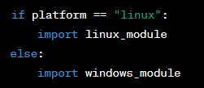
Conditional Imports
You can use conditional imports to import modules based on certain conditions. For example, you might want to use one module on Windows and another on Linux:

Slide 7
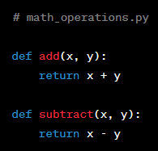
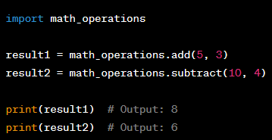
Creating Own Module
You can create your own modules by creating a Python file with the .py extension and defining functions, classes, or variables within it. These can then be imported and used in other parts of your code.

Slide 8
Class Activity
Complete Address Book
Update Contact
Remove Contact
Search Contact

Slide 9
Assignment 10:
Objective: The objective of this assignment is to design and implement a scientific calculator in Python. The calculator should be capable of performing various mathematical operations, including basic arithmetic, trigonometric functions, logarithmic functions, and more.
Note: Use your previous assignment of calculator and modify it to make it scientific calculator

Slide 10
Assignment 10:
Requirements:
Use math module or library to make your task easy.
Make it as simple as possible
I will also upload the code for the basic calculator. Modify existing one.

